Slide 1
dwo_icecream
5
dwo_icecream[1]
10
dwo_icecream[2]
8
dwo_icecream[3]
9
dwo_icecream[4]
3
dwo_icecream[5]

Slide 2
[ , 1]
[ , 2]
[ , 3]
[ , 4]
[1, ]
[1,1]
[2, ]
[3, ]
[3,4]
[4, ]
[5, ]
[5,2]

Slide 3
dwo_icecream
dog_lover
names
pushups
[ , 1]
[ , 2]
[ , 3]
[ , 4]
[1, ]
[1,1]
[2, ]
[3, ]
[3,4]
[4, ]
[5, ]
[5,2]

Slide 4
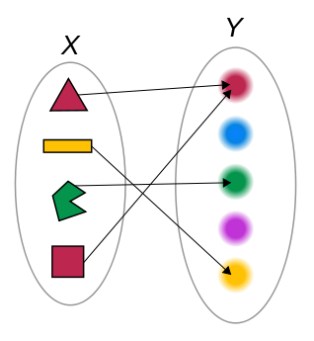
f

